Slide 1


Module 2
ORTHOGRAPHIC PROJECTIONS
Sheba Varghese
Asst. Professor
Department of Mechanical Engineering
Room – A310
KJSCE, Vidyavihar
E-mail – sheba@somaiya.com

Slide 2
ORTHOGRAPHIC PROJECTION
Orthographic Projection is a technical drawing in which different views of an object are projected on different reference planes observing perpendicular to respective reference plane.
The Different Reference planes are: The Different views are :
Horizontal Plane (HP) Top View (TV) – Projected on HP
Vertical Plane (VP) Front View (FV) – Projected on VP
Side or Profile Plane (PP) Side View (SV) – Projected on PP

Slide 3
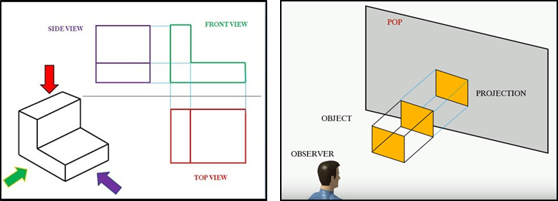
Orthographic Projection
Orthographic Projection: The projection in which the projectors are parallel to each other and perpendicular to the plane

Slide 4
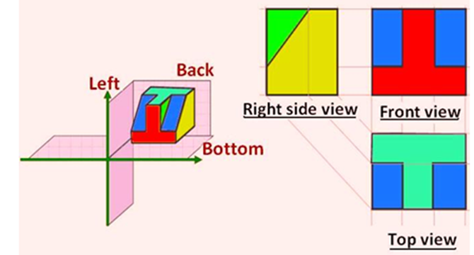
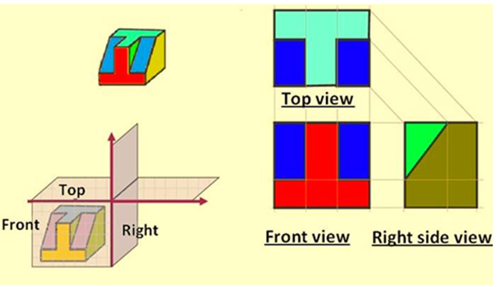
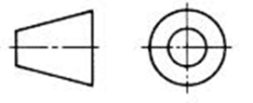
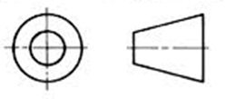
First & Third angle Projection Method
First Angle Projection Method
Third Angle Projection Method

Slide 5
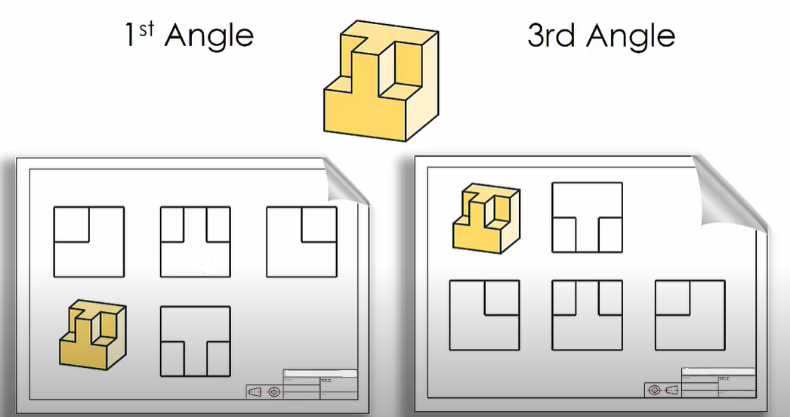
First angle & Third angle projection

Slide 6
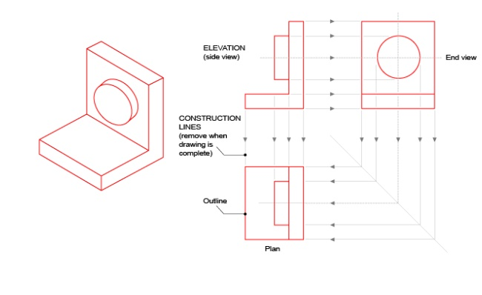
Practice

Slide 7
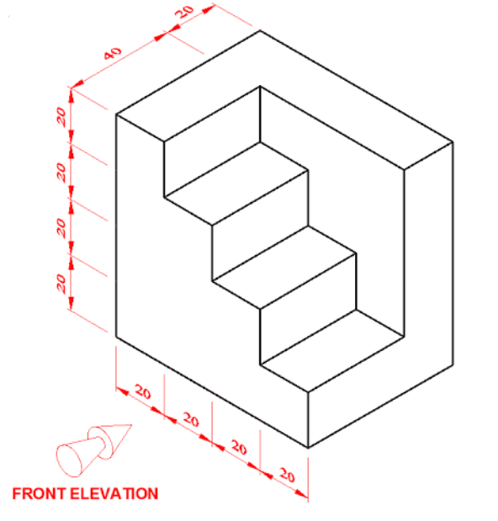
Practice

Slide 8
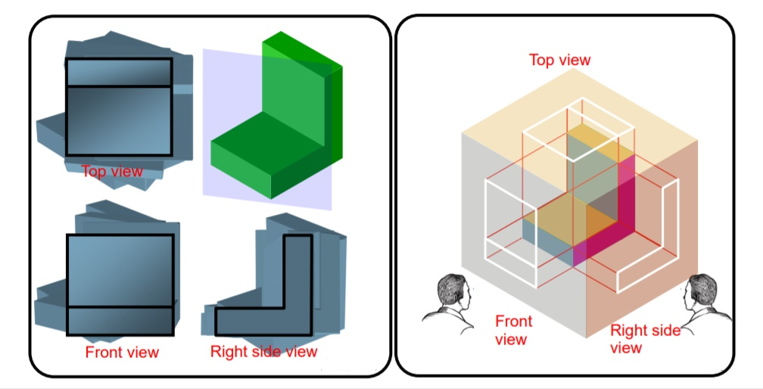
Methods of Orthogonal Projections
Natural Method : Revolves the object with respect to the observer.
Glass Box Method / Transparent Method : The observer moves around the object.
1.
2.

Slide 9

Glass Box Method
The object is assumed to be placed in a glass box.
The 6 sides of the box will be made by the 6 mutually perpendicular planes of projection that are located around the object. Each views will be projected on those planes.
Unfolding the box produces an arrangement of the six views.
Top view
Rear view
Left view
Front view
Right view
Bottom view

Slide 10
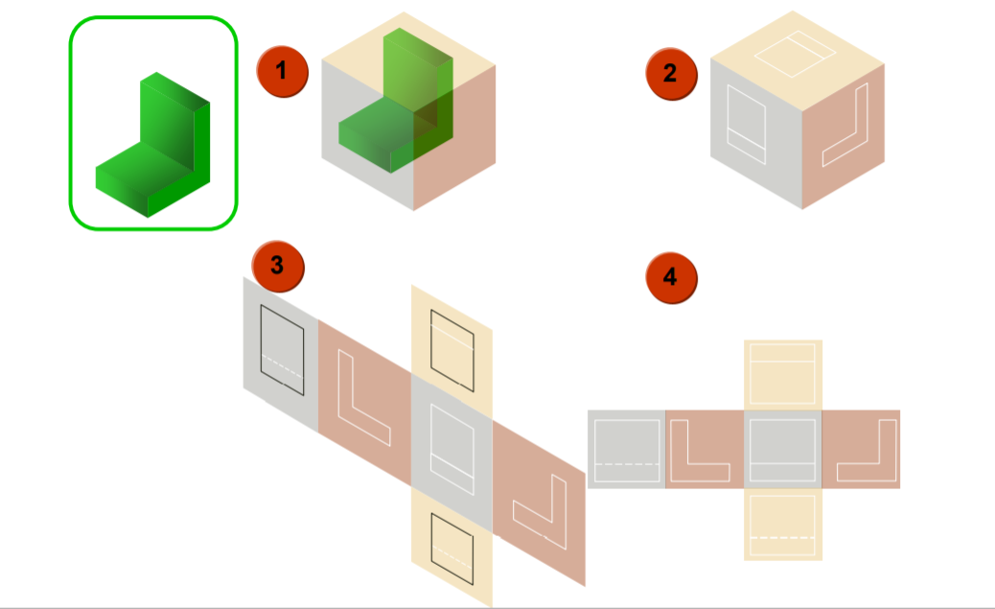
Problem solving Steps

Slide 11
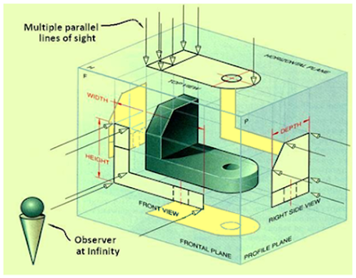
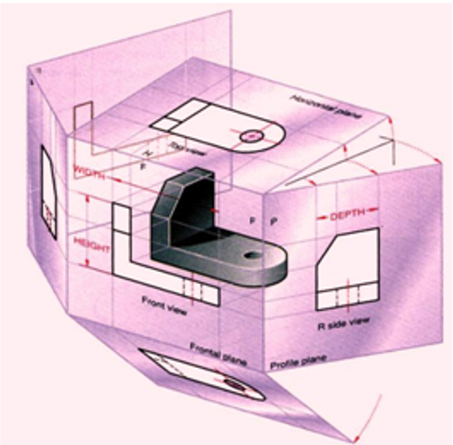
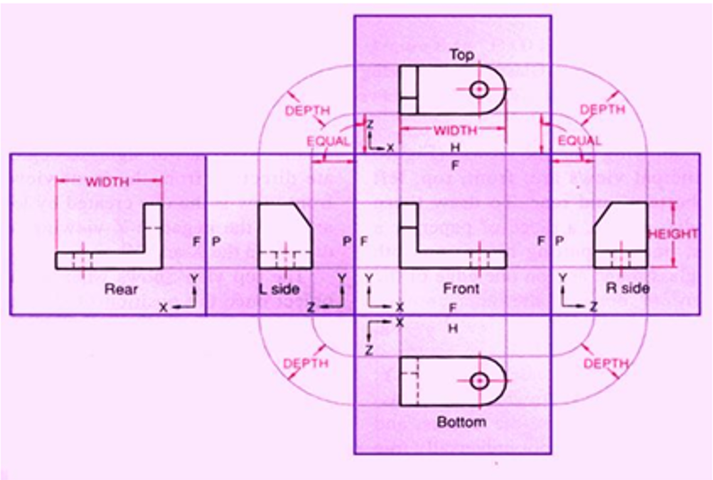
Method of Orthographic Projection

Slide 12
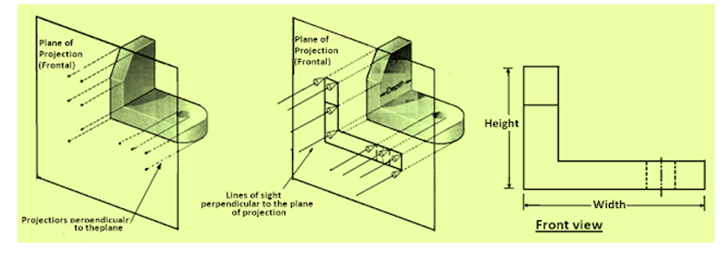
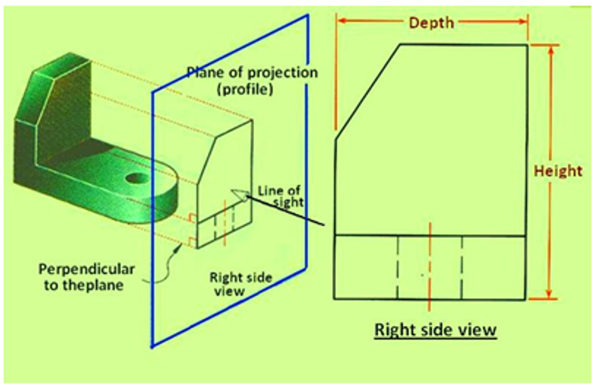
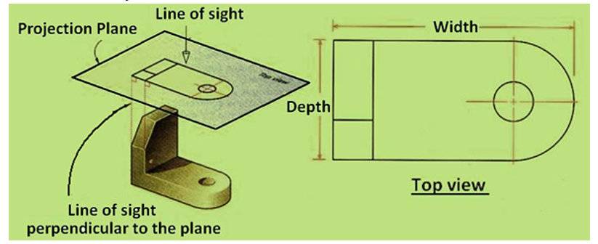
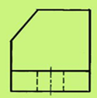
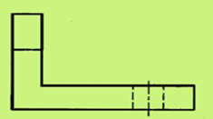
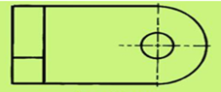
Method of Orthographic Projection
Frontal Plane of Projection
Profile Plane of Projection
Horizontal Plane of Projection

Slide 13
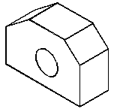
Object Dimensions
Top View
Shows width & depth
Front View
Shows width & height
Side View
Shows height & depth
Depth can be projected between views by using a 45° line
(Third angle projection)

Slide 14
Choosing Views
Views should be visually balanced within the working space.
Complex objects require 3 views describe its shape fully.
Simple objects require only two views. Third view would add nothing to the description.
Some curved surfaces do not show as curves in all views.
wheel
cylinder

Slide 15
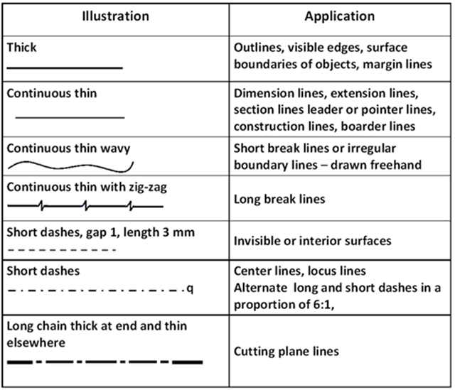
Line Types
Lines signify more than just the geometry of the object so its important to use the appropriate line type.
Is the feature visible or hidden from view?
Is the line part of the object or part of a dimension?
Is the line indicating symmetry?

Slide 16
Precedence of Lines
Visible lines takes precedence over all other lines.
Hidden lines and cutting plane lines take precedence over center lines
Center lines have lowest precedence
NOTE:
When the Visible line coincides with hidden or center line
- Visible line is shown
Hidden line coincides with center line
- Hidden line is shown

Slide 17
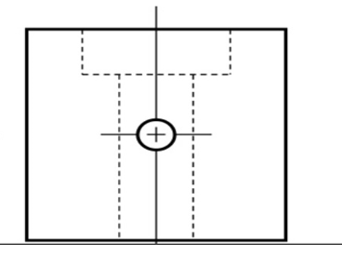
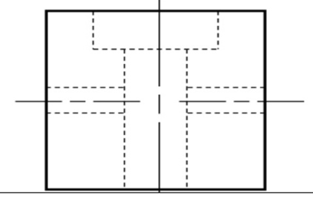
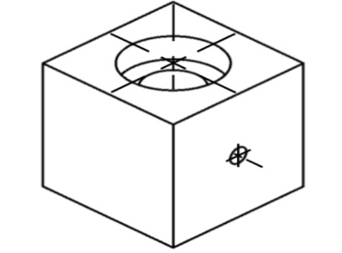
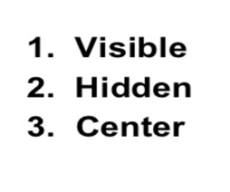
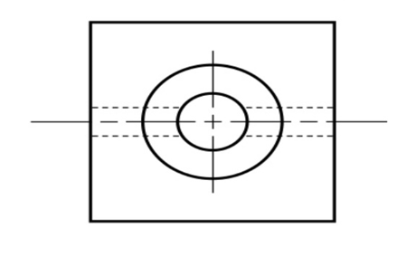
Precedence of Lines

Slide 18
Straight Edges
Edges that are perpendicular to a plane of projection appear as a point.
Edges that are parallel to a plane of projection appear as lines
Edges that are inclined to a plane of projection appear as foreshortened lines
1.
2.
3.
T.V
F.V

Slide 19
Curved Edges
Curved edges project as straight lines on the plane to which they are perpendicular
Curved edges project as curved lines on the planes to which they are parallel or inclined

Slide 20

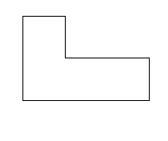

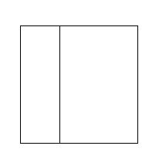
Normal Surfaces
Normal surfaces appear as an edge in two opposite principal views, and appear a surface in all other principal views.

Slide 21


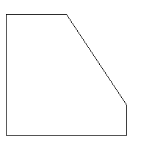

Inclined Surfaces
Inclined surfaces appear as an edge in two opposite principal views, and appear foreshortened (not true size) in all other principal views.

Slide 22
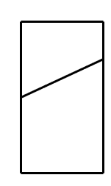
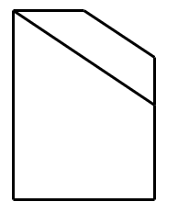
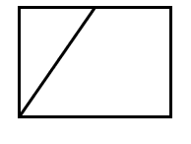
Oblique Surfaces
Oblique surfaces do not appear either as an edge or true size in any principal view.

Slide 23
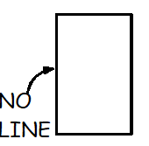
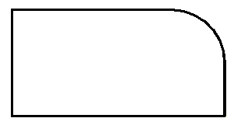
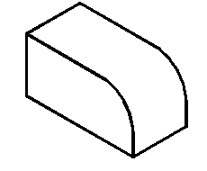
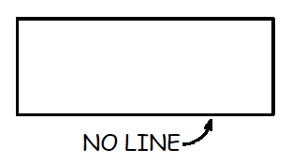
Intersections & Tangencies
Where a curved surface is tangent to a plane surface, no line should be shown where they join

Slide 24
Intersections & Tangencies
Where a plane surface intersects a curved surface, an edge is formed

Slide 25
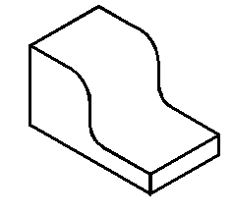
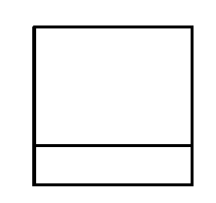
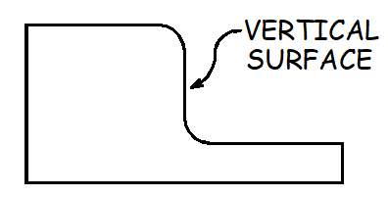
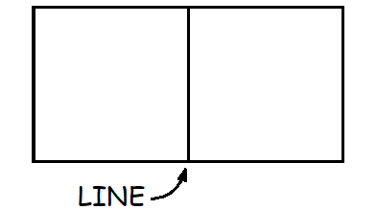
Intersections & Tangencies
Where the plane surface is horizontal or vertical, exceptions to these rules may occur

Slide 26
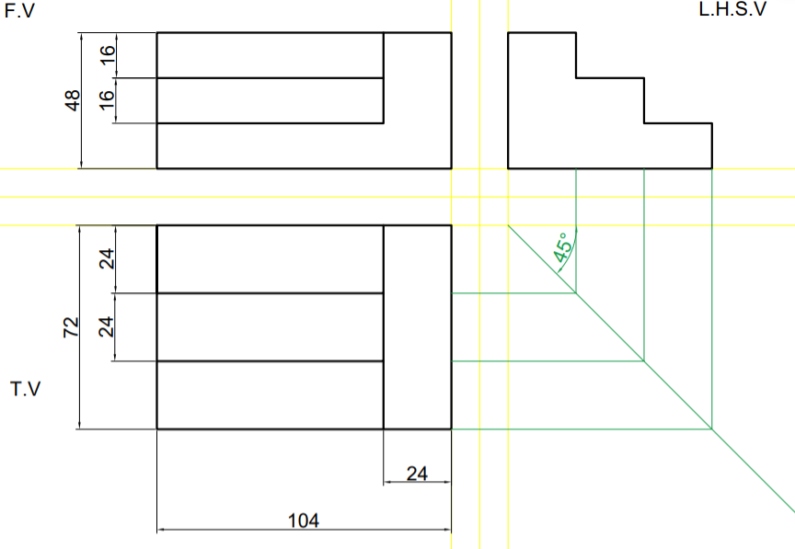
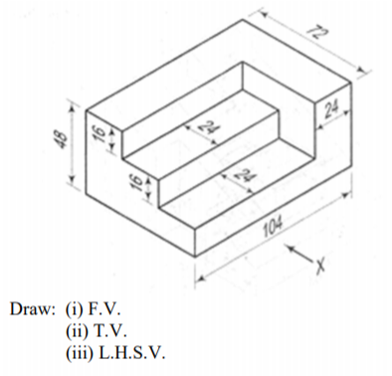
Practice Problem 1
Figure below show pictorial views. Draw the T.V, F.V and LHSV views using first angle method of projections.

Slide 27
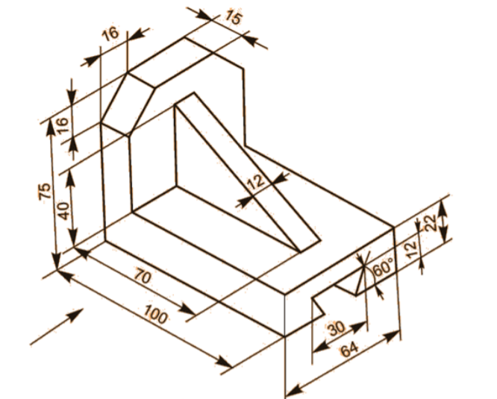
Practice Problem 2
Figure below show pictorial views. Draw the T.V, F.V and RHSV views using first angle method of projections.

Slide 28
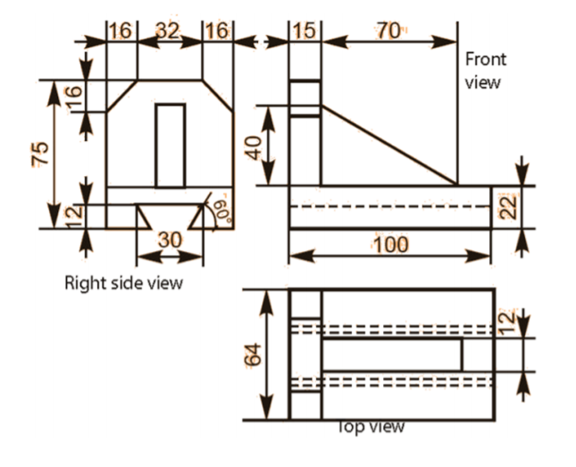
Practice Problem 2
Figure below show pictorial views. Draw the T.V, F.V and RHSV views using first angle method of projections.

Slide 29
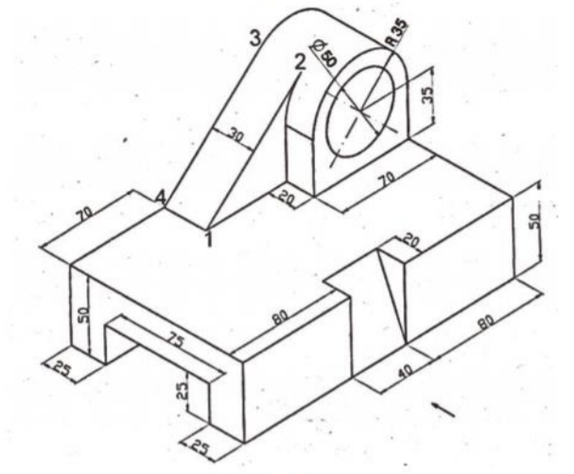
Practice Problem 3
Figure below show pictorial views. Draw the T.V, F.V and LHSV views using first angle method of projections.
X

Slide 30
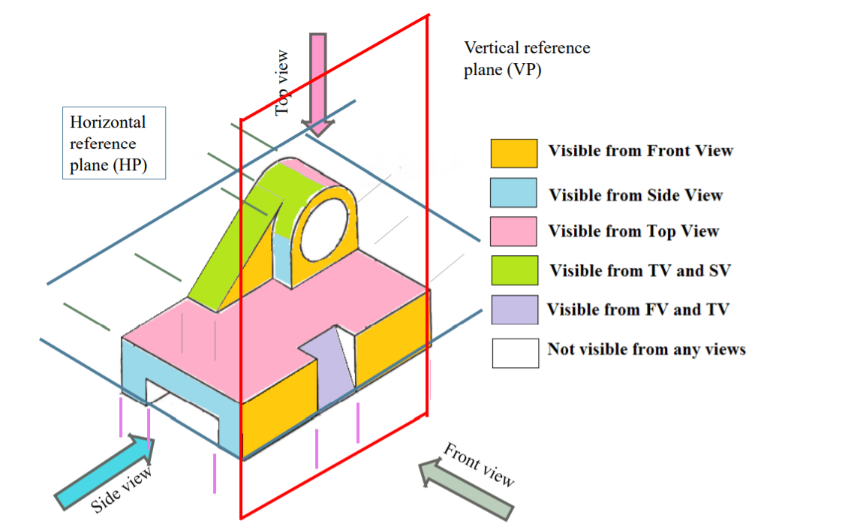
Practice Problem 3

Slide 31
Practice Problem 3
X

Slide 32
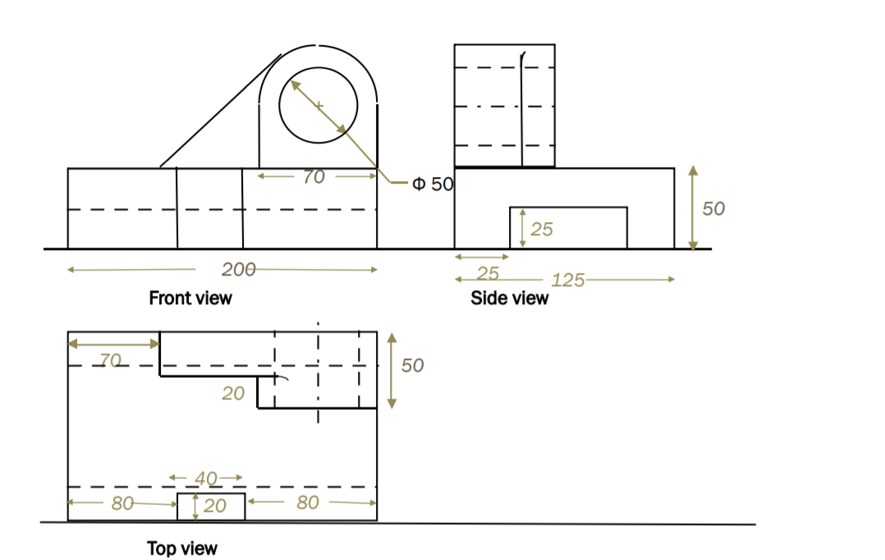
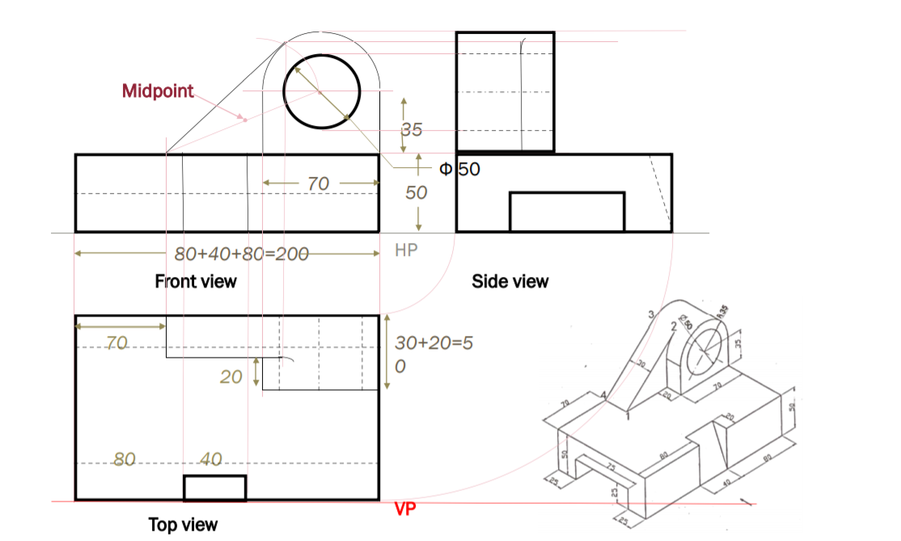
Practice Problem 3 - solution

Slide 33
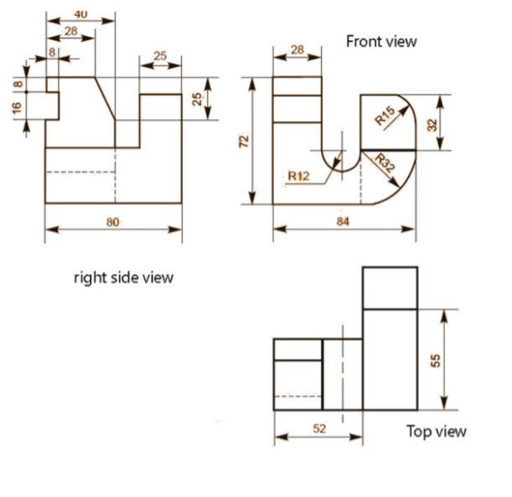
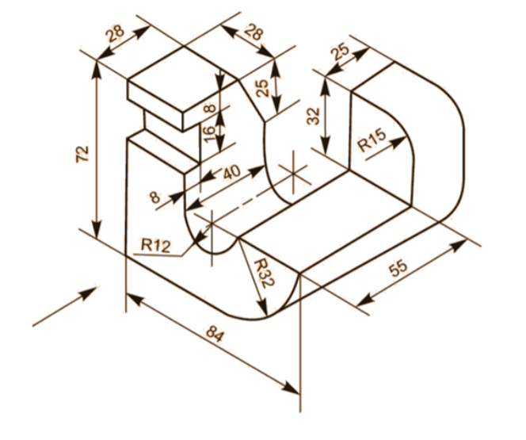
Practice Problem 4
Figure below show pictorial views. Draw the T.V, F.V and RHSV views using first angle method of projections.

Slide 34

Practice Problem 5
Figure below show pictorial views. Draw the T.V, F.V and RHSV views using first angle method of projections.

Slide 35

Practice Problem 5
Figure below show pictorial views. Draw the T.V, F.V and RHSV views using first angle method of projections.

Slide 36


Practice Problem 6
Figure below show pictorial views. Draw the T.V, F.V and LHSV views using first angle method of projections.

Slide 37

Practice Problem 7
Figure below show pictorial views. Draw the T.V, F.V and LHSV views using first angle method of projections.

Slide 38

Practice Problem 8
Figure below show pictorial views. Draw the T.V, F.V and LHSV views using first angle method of projections.

